Slide 1

131st Maine Legislature
Meeting of the Government Oversight Committee
(“The GOC”)
Friday, January 13, 2023
Notes:
Good morning, Chair Hickman, Chair Fay, Lead Keim, Lead Millett, and other Distinguished Members of the Government Oversight Committee of the 131st Maine Legislature.
We, the Director and staff of the Office of Program Evaluation and Government Accountability, including the Committee’ clerk, Sabrina Carey, have assembled these orientation slides and we will be as brief about them as possible.
At the front of your books at your seats, is the agenda and meeting specific materials in numbered tabs.
At the back of each book will remain certain standing reference materials, with a Table of Contents, for reference, as needed.

Slide 2
Chairs, Leads, and Other Distinguished Members
Of the 131st GOC
Senator Craig Hickman, Chair
Senator Lisa Keim, Lead
Senator Richard Bennett
Senator Jill Duson
Senator Jeff Timberlake
Senator Michael Tipping
Representative Jessica L. Fay, Chair
Representative H. Sawin Millett, Lead
Representative Amy Arata
Representative Mark Blier
Representative Anne-Marie Mastraccio
Representative Maggie O’Neil
Notes:
And here is a list of the names of the Director and staff of OPEGA, including the Committee Clerk, Sabrina Carey, who also serves as OPEGA’s Administrative Secretary, along with office contact information:
Peter Schleck, OPEGA Director
Matt Kruk, Principal Analyst
Scott Farwell, Senior Analyst
Jennifer Henderson, Senior Analyst
Amy Gagne, Senior Analyst
Kari Hojara, Analyst
Joel Lee, Analyst
Lisa Plimpton, Analyst
Sabrina Carey, Administrative Secretary (and GOC Clerk)
Mailing Address:
82 State House Station
Augusta, Maine 04333-0082
Phone: (207) 287-1901
Fax: (207) 287-1906
Web: http://legislature.maine.gov/opega

Slide 3
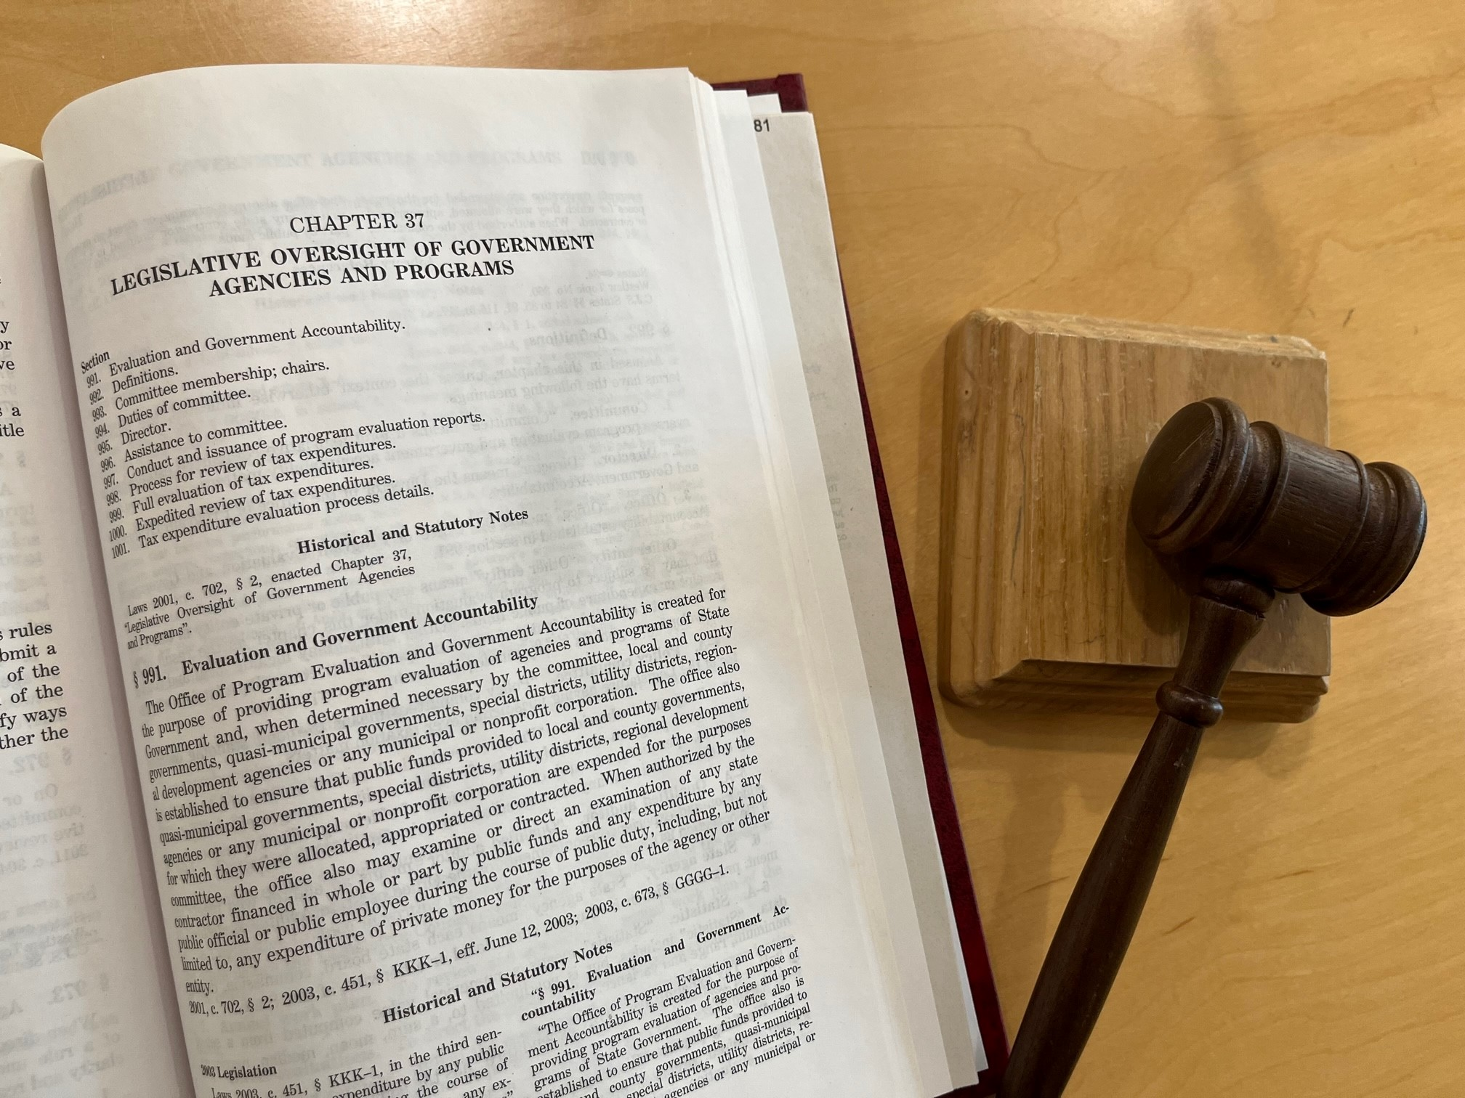
Notes:
A complete copy of Title 3, Chapter 37 of the Maine Revised Statutes may be found at Tab A in your Binder, as part of the standing reference materials. See alphabetical tabs and the accompanying table of contents.
The OPEGA Director will be highlighting key points in this presentation, as they describe Committee and OPEGA authorities. Going forward, as the next meeting’s materials are copied into your binder, standing reference materials will remain in the back of the notebook for your ongoing reference.
OPEGA will also generally send you electronic versions of meeting materials at least the evening before a scheduled meeting and even sooner, if possible.

Slide 4
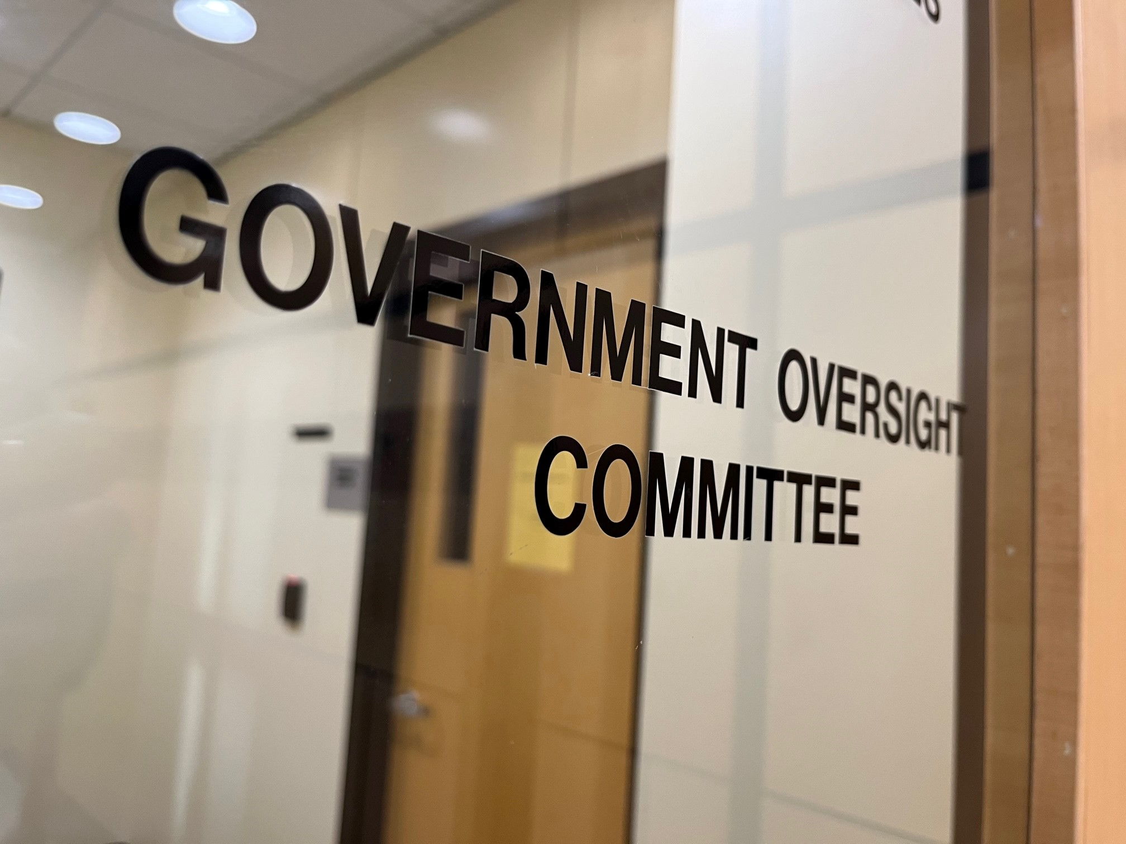
“A joint legislative committee established to oversee program evaluation and government accountability matters.” 3 M.R.S. § 992(1)
“The membership of the committee and the selection of chairs are established by joint rule of the Legislature.” 3 M.R.S. § 993

Slide 5
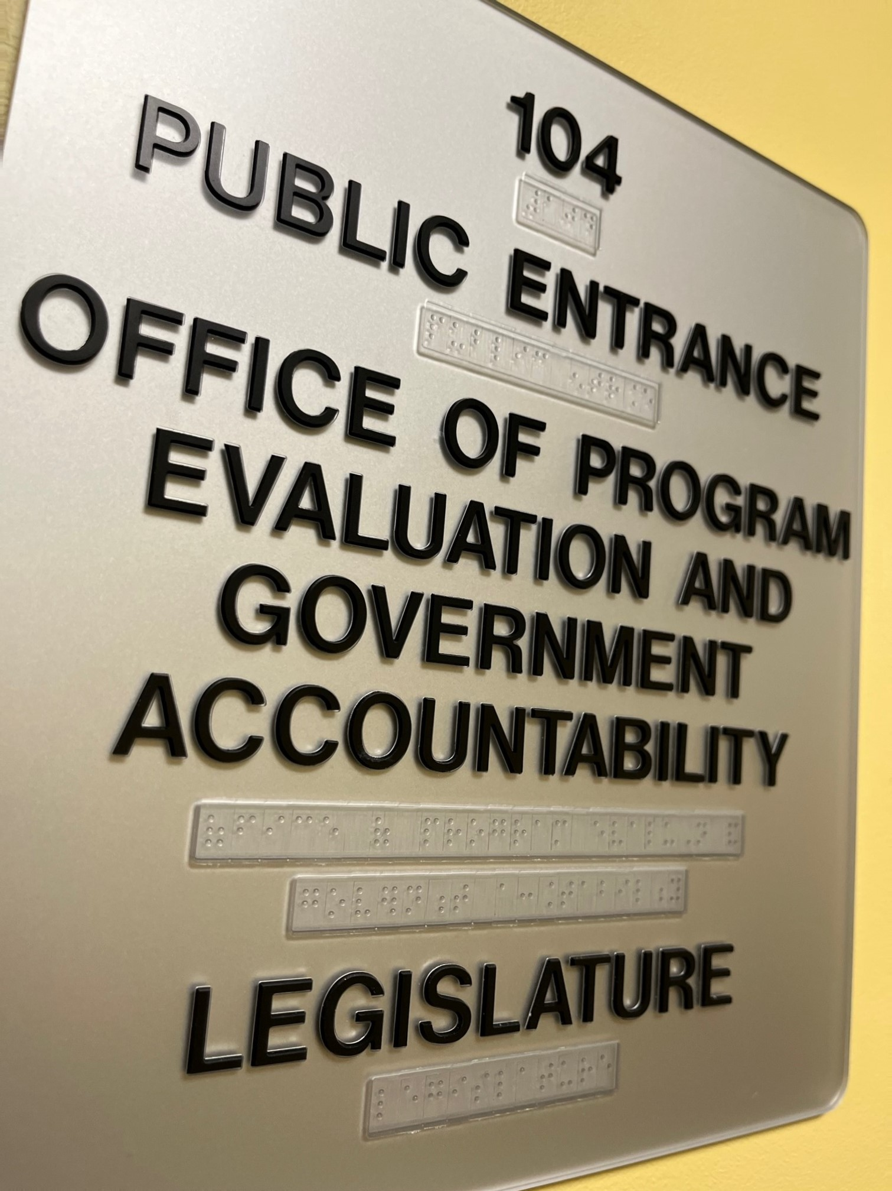
“OPEGA”
“. . . created for the purpose of providing program evaluation of agencies and programs of State Government . . ..” 3 M.R.S. § 991

Slide 6

“The GOC”
Per 3 M.R.S. § 994:
Evaluates the OPEGA Director
Recommends in writing to the Legislative Council whether to reappoint the OPEGA Director (following initial 5-year term (3 M.R.S. § 995))
Reviews and approves the annual OPEGA Workplan
Directs OPEGA to conduct program evaluations
Requests the State Auditor to assist OPEGA, when necessary, or authorizes OPEGA to obtain other audit services

Slide 7
The GOC (cont’d)
Per 3 M.R.S. § 994:
Holds public hearings for the purpose of receiving reports from OPEGA and questioning public officials about OPEGA findings and recommendations
Examines witnesses and orders the appearance of any person (including to produce records)
Administers oaths to GOC witnesses under certain circumstances
Votes, at the GOC’s discretion, to endorse, endorse in part, or to release an OPEGA report without endorsement

Slide 8
The GOC (cont’d)
Per 3 M.R.S. § 994:
Issues subpoenas under certain circumstances
Conducts meetings at such times as the co-chairs determine necessary
Adopts GOC rules (including a mission statement)
Receives certain information. Information that is made available to the GOC is governed by statutes for legislative investigating committees, and those regarding public records and proceedings
Establishes a system for immediate review of State agency or entity program or function where suspected of major mismanagement of public funds or functions
Notes:
In your binder, there is a copy of the GOC and OPEGA Mission statements previously adopted, at Tab B.
You will also find a copy of the 130th GOC rules for consideration, discussion, amendment, and potential adoption, perhaps at our next meeting. See Tab D.

Slide 9
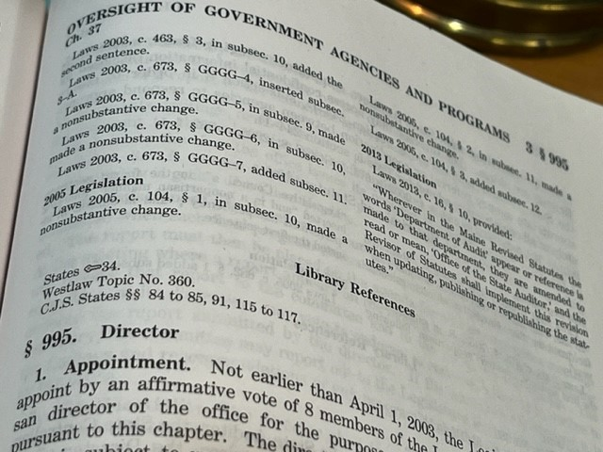
OPEGA is led by a Director
Per 3 M.R.S. § 995:
Appointed by the Legislative Council
Terminated only for cause by an affirmative vote of 8 members of the Legislative Council
Supervises staff in accordance with GOC and Legislative Council policies. OPEGA employees, including the Director, must be non-partisan.
Prepares and presents a biennial budget, and an Annual Workplan, for GOC approval
Notes:
A one page summary of the roles and responsibilities of OPEGA, and also those of the GOC, may be found at Tab C in your binder.

Slide 10
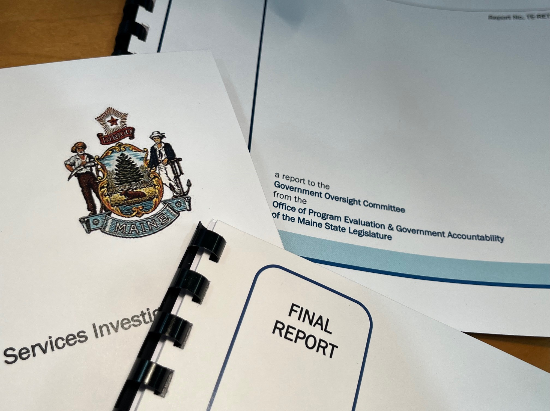
OPEGA
Program
Evaluations
Per 3 M.R.S. § 997:
Agency under review has 15 days to comment on an OPEGA draft, and if it does, the comments will be included in the report submitted to the GOC
Director notifies GOC a report is completed, which is then put on the agenda for a future GOC meeting
Notes:
See Table of Contents in Binders for additional details.

Slide 11
OPEGA Program Evaluations
(cont.)
Per 3 M.R.S. § 997:
GOC may vote to endorse, endorse in part, or decline to endorse the OPEGA report
GOC may report out legislation to implement OPEGA findings and recommendations
An OPEGA report is released to public same day as it appears on GOC meeting agenda for the first time

Slide 12
Mandated Schedules of “Tax Expenditure” Reviews
Per 3 M.R.S. §§ 998-1001.
We plan to brief the GOC on the Tax Review process at a future meeting.
“…those state tax revenue losses attributable to provisions of Maine tax laws that allow a special exclusion, exemption or deduction or provide a special credit, a preferential rate of tax or a deferral of tax liability.” See 3 M.R.S. § 992 (adopting the definition of “tax expenditure” found in 5 M.R.S. § 1666).
Notes:
The statutory sections setting forth these tax-related processes are found at 3 M.R.S. § § 998-1001, which is included in your Binder, at Tab A.

Slide 13
Information Available to OPEGA
Per 3 M.R.S. § 997:
Agencies must provide OPEGA access to privileged and confidential information, upon request, subject to certain conditions
OPEGA is then subject to the same restrictions as the Agency

Slide 14
Examples of Past OPEGA Review Topics
MaineCare Durable Medical Equipment & Medical Supplies (2009)
Highway Fund Eligibility at the Department of Public Safety (2007)
Maine Turnpike Authority (2011)
Follow-up Review of Health Care in the State Correctional System (2014)
Emergency Communications in Kennebec County (2010)
Maine Capital Investment Credit (2020)

Slide 15

Thank you for the opportunity to be of assistance. We welcome your questions.

